Slide 1

ANTIVIRUS
Bilal Ahmad Khan
Abdul Munam
Junaid Muhammad

Slide 2
What is Antivirus
Antivirus is a kind of software used to prevent, scan, detect and delete malware(malicious software) such as viruses from a computer. Before talking about antivirus, we should know what threats it protects from.

Slide 3
What is a Virus
Like the biological term 'virus', viruses in computers work on the same principle. It is essentially a piece of code(a software) that attaches itself with other files, infecting them and replicating itself with the intention of altering or destroying files. This virus may be injected through an email attachment, via USB or any contact with an external network.

Slide 4
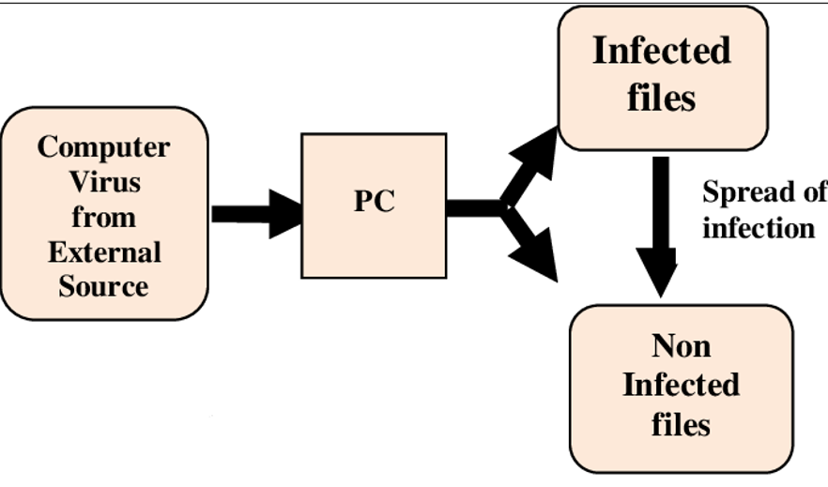

Slide 5
List of other Threats
Phishing
Ransomware
Trojan
Worm
Adware
Spyware
Hacking
Bots

Slide 6
HISTORY of Antivirus
Antivirus software was originally developed to detect and remove computer viruses, hence the name. However, with the proliferation of other malware, antivirus software started to protect against other computer threats. Some products also include protection from malicious URLs, spam, and phishing.
The origins of antivirus software may be traced back to 1971, during which the initial instance of a computer virus, named Creeper, emerged and propagated among PDP-10 mainframe computers produced by Digital Equipment Corporation (DEC). The development of the Reaper was undertaken by American computer programmer Ray Tomlinson as a means to counteract the Creeper.
The First True Antivirus Software
In the year 1987, Bernd Robert Fix, a renowned German computer security expert, developed a software program with the objective of eliminating the Vienna virus. This particular virus had the capability to infect .com files specifically on systems operating on the DOS platform.

Slide 7
Early Viruses
...talk about John von Nuemans idea of computer programs replicating itself in 1949 and Elk Cloner
The Creeper - 1971
ILOVEYOU - 2000
MyDoom – 2004
Chernobyl - 1998

Slide 8
The need for Antivirus
Knowing that a program of size in KBs can destroy whole computers and affect multiple lives, the need for antivirus is important. Using an antivirus includes multiple advantages, some of them being:
Protect Personal Data: Shield sensitive information from theft and prevent Data Loss and Theft:
Email and Web Protection: Antivirus software often includes features that protect you from malicious email attachments, phishing scams, and dangerous websites.
Safe Online Banking and Shopping: Antivirus solutions contribute to the security of online financial transactions and shopping by safeguarding against banking trojans and other threats that attempt to steal login credentials and financial information.
System Performance Optimization: Some antivirus programs include tools to optimize system performance by identifying and removing unnecessary files, temporary data, and other elements that can slow down your device. This can help maintain the efficiency of your computer.
Prevent Financial Loss: Stop ransomware attacks demanding payment for data decryption.
Maintain System Integrity: Ensure your device functions without compromise.
Protection Against Malware: Antivirus software is designed to detect, prevent, and remove malicious software, commonly known as malware. This includes viruses, worms, trojan horses, ransomware, spyware, and other types of harmful programs that can compromise the security and functionality of your devices.

Slide 9
Methods of threat identification
Signature Based Detection: This method involves creating unique signatures or fingerprints for known malware. These signatures are like digital footprints that antivirus programs use to identify and quarantine malicious files. Antivirus software compares the files on a system against a database of these signatures. If a match is found, the file is flagged as malware and appropriate action is taken.
Heuristic Analysis: Heuristic analysis is a proactive approach where the antivirus program looks for traits or behaviors commonly associated with malware. Rather than relying on predefined signatures, it identifies potential threats based on suspicious characteristics. The software evaluates the behavior of files and applications, flagging those that exhibit unusual or potentially harmful actions. This allows the antivirus to catch new or previously unknown threats.
Behavioral Analysis: Behavioral analysis monitors the real-time behavior of programs and processes on a system. It seeks patterns or actions that deviate from normal, legitimate behavior. Antivirus programs observe how applications interact with the system. If an application starts behaving in a way typical of malware (e.g., attempting to modify critical system files), it is flagged for further investigation or immediate action. This method may be considered a subset of heuristic analysis.
Real-Time Protection: Real-time protection ensures that antivirus software is actively monitoring the system for potential threats as they occur. The antivirus program runs in the background, continuously scanning files, emails, downloads, and other activities. If it detects any suspicious activity or a match with known malware signatures, it takes instant action to block or quarantine the threat.

Slide 10
What happens next
Depending on the defined settings, one or many of the following actions take place:
Quarantine:
The antivirus isolates the identified threat, placing it in a secure, quarantined area on the system. This prevents the malware from spreading or causing harm while allowing further analysis.
Alert Notification:
Users are promptly informed about the detection through alert notifications. This transparency keeps users aware of potential risks and actions taken by the antivirus.
Automated Cleaning:
In many cases, the antivirus attempts to automatically clean or repair the infected files. This involves removing or neutralizing the malicious elements, restoring the file to a safe state.
Blocking and Removal:
The antivirus blocks the execution of malicious files in real-time, preventing them from causing harm. Additionally, it may initiate the removal of the threat from the system.

Slide 11
What happens next
Update Definitions: To stay ahead of evolving threats, the antivirus regularly updates its signature database with new definitions. This ensures that the system is protected against the latest known malware.
User Guidance:
Antivirus software often provides guidance to users on additional steps they can take to enhance their security, such as updating software, strengthening passwords, or avoiding certain online activities.
Logs and Reports:
Antivirus programs maintain logs and reports detailing the actions taken against threats. This information can be valuable for users and IT administrators in understanding the security landscape of the system.
Continuous Monitoring:
Even after initial detection and response, the antivirus continues to monitor the system for any signs of further malicious activity. This ongoing vigilance ensures sustained protection against potential threats.

Slide 12
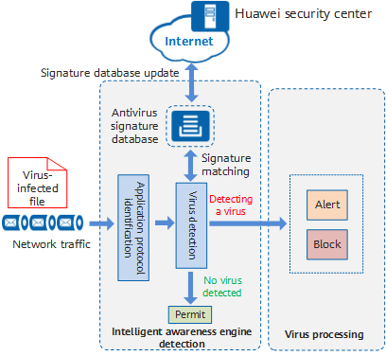

Slide 13
Types of Antivirus
1.Local Installed Antivirus:
A locally installed antivirus refers to antivirus software that is installed directly on an individual device, such as a computer or laptop. Unlike cloud-based or network-based solutions, which may provide protection across multiple devices or an entire network, a locally installed antivirus is specific to the device on which it is installed.
Offline Protection: Once installed, the locally installed antivirus can operate independently of an internet connection. It doesn't require constant connectivity to a central server for protection.
Signature-Based Detection: Many locally installed antivirus solutions rely on signature-based detection, using a database of known malware signatures to identify and remove threats.
Device-Specific Configuration: Users can typically configure settings and preferences specific to the device on which the antivirus is installed. This may include specifying scan schedules, setting quarantine options, and defining other security parameters.
Resource Utilization: Locally installed antivirus software may consume system resources on the device where it is installed. The impact on system performance can vary based on the specific antivirus program and the device's capabilities.

Slide 14
Types of Antivirus
2.Cloud-based Antivirus:
Cloud-based antivirus refers to antivirus solutions that leverage cloud computing resources for various aspects of threat detection, analysis, and protection. Unlike traditional locally installed antivirus software that relies on databases stored on individual devices, cloud-based antivirus offloads certain tasks to a remote cloud infrastructure.
Cloud-Based Detection: Cloud-based antivirus solutions use cloud servers to perform real-time analysis of files and potential threats. Instead of relying solely on local databases, these solutions access a centralized cloud repository for up-to-date threat intelligence.
Reduced Local Footprint: Cloud-based antivirus can reduce the need for extensive local databases and resource-intensive processes on individual devices. This can result in lower impact on system performance compared to some traditional antivirus solutions.
Scalability: Cloud-based solutions are often more scalable, allowing for easy adaptation to the growing number of connected devices in a network. This is particularly beneficial for businesses with evolving IT infrastructures.
Centralized Management: Cloud-based antivirus often includes a centralized management console accessible via a web interface. This allows administrators to oversee and manage security settings across multiple devices and users from a single point.

Slide 15
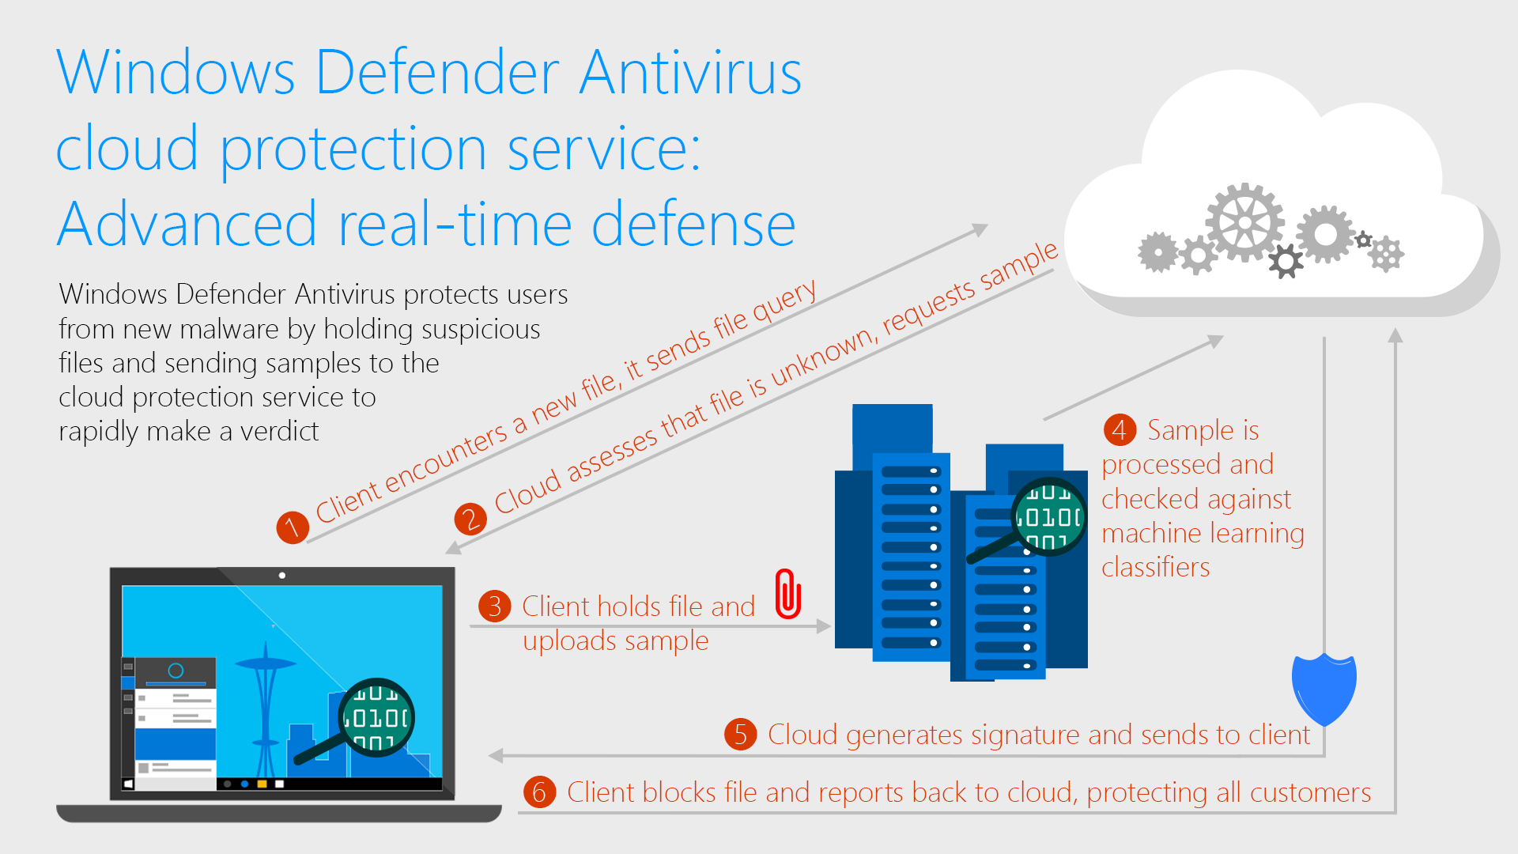

Slide 16
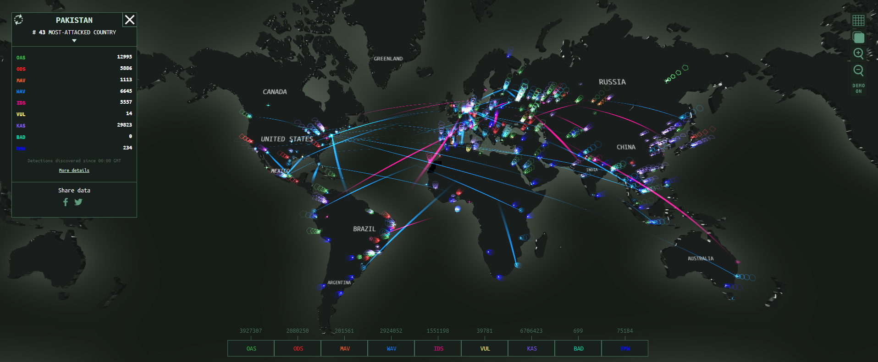
https://cybermap.kaspersky.com/

Slide 17

Practices to stay safe from Viruses
Regular Updates: Keep antivirus and system software up to date.
Safe Browsing Habits: Avoid suspicious websites and downloads.
Email Vigilance: Be cautious with email attachments and links.

Slide 18
Antivirus in Modern Era
With constant improvement in technology day-by-day, newer threats emerge and there is always a need for some software to fight against these threats. Antivirus does some of its part in this.
Machine Learning and Artificial Intelligence:
Modern antivirus solutions increasingly leverage machine learning and artificial intelligence (AI) algorithms to enhance threat detection. These technologies enable the antivirus to analyze patterns, behaviors, and anomalies, improving its ability to identify new and previously unknown threats.
Cloud-Based Protection:
Cloud-based antivirus solutions utilize cloud infrastructure for real-time threat intelligence, analysis, and updates. This enables faster response times to emerging threats and reduces the reliance on local databases. Centralized management consoles in the cloud facilitate monitoring and control across entire networks.
Mobile Security:
Mobile devices are a prominent target for cyber threats. Modern antivirus solutions extend their protection to smartphones and tablets, offering features such as app scanning, secure browsing, and anti-theft functionalities.

Slide 19
Antivirus in Modern Era
Privacy Protection:
Privacy concerns have led to an increased focus on protecting user data. Modern antivirus solutions often include features that safeguard user privacy, such as blocking tracking cookies, preventing data exfiltration, and ensuring secure online transactions.
Quantum Computing Preparedness:
As quantum computing advances, there will be a need for antivirus solutions to adapt and develop cryptographic algorithms that are resistant to quantum attacks. Quantum-safe encryption methods may become a standard feature.
Blockchain for Security Assurance:
Utilizing blockchain technology for security assurance can enhance the integrity of antivirus updates and provide a transparent and immutable record of security events.
Cyber Threat Hunting:
Antivirus solutions may incorporate more advanced threat hunting capabilities, leveraging human analysts and AI-driven algorithms to actively seek out and identify potential threats before they cause harm.

Slide 20
Top Antivirus Options
Norton
Bitdefender
McAfee
Avast
PC Protect
Panda

Slide 21
Antivirus in Pakistan
#43 Most attacked in world
Lack of education/awareness
Growing Freelance Hub so need protection
Amongst top 10 most scamming countries so we are a potential target
Everything turning online so proper protection and awareness is mandatory.
Protection against ransoms.

Slide 22
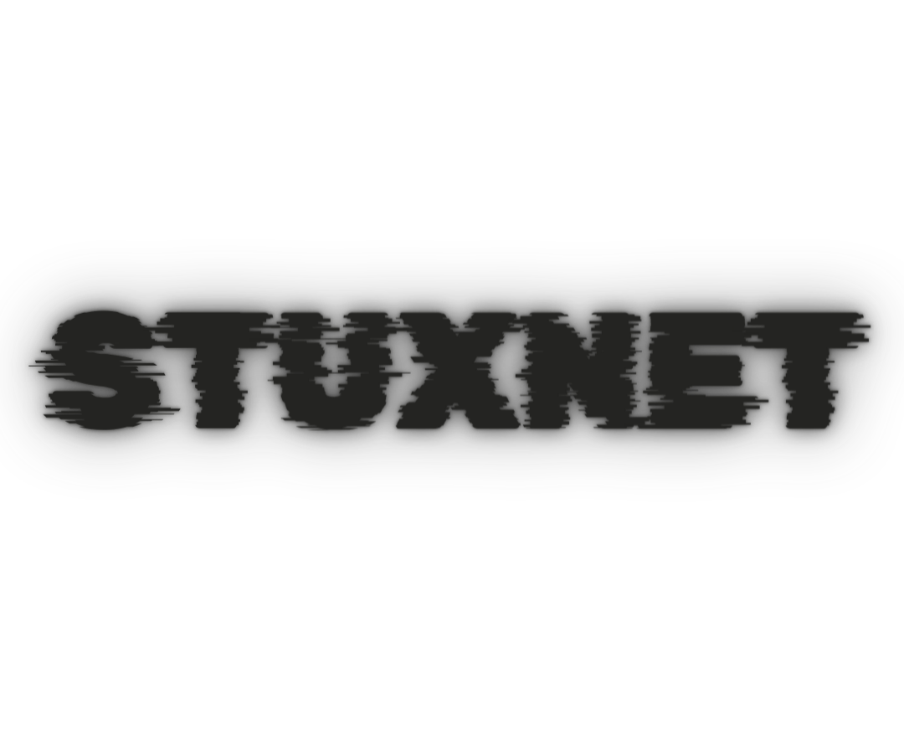
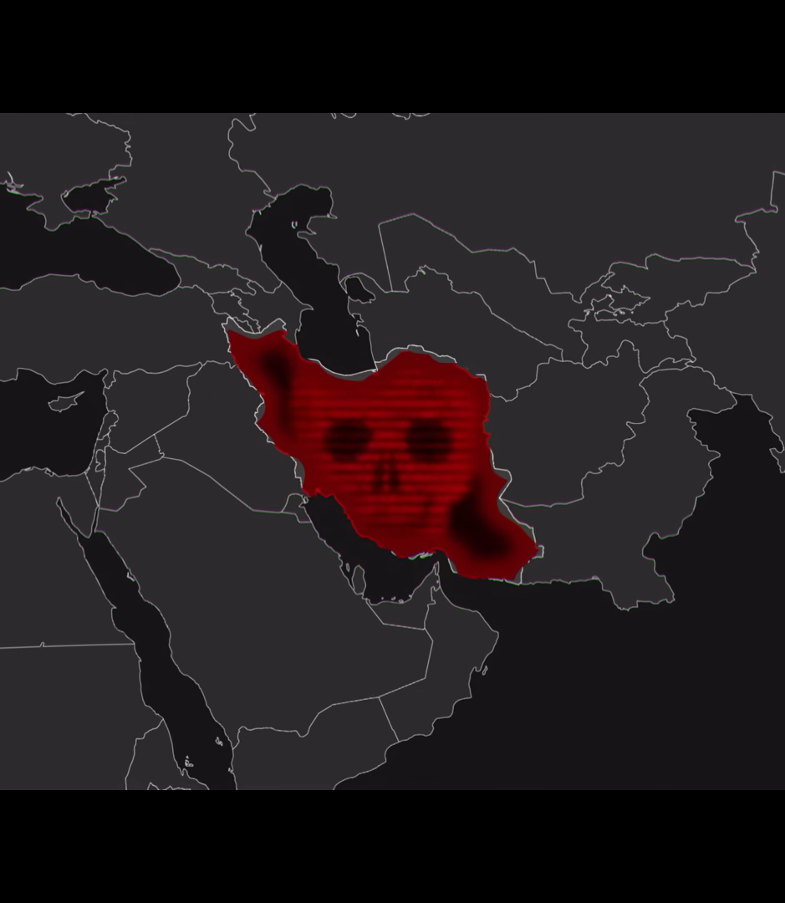
Targeted Iran Nuclear Facility (Natanz)
Sabotages software used to control centrifuges' speeds.
Centrifuges are spun at super sonic speeds with uranium hexa fluoride.
Upon enriching the uranium, a high pressure is built by gas.
Stuxnet closes the valves for gas excretion
Gas solidifies, vessels spun out of control + may explode.

Slide 23
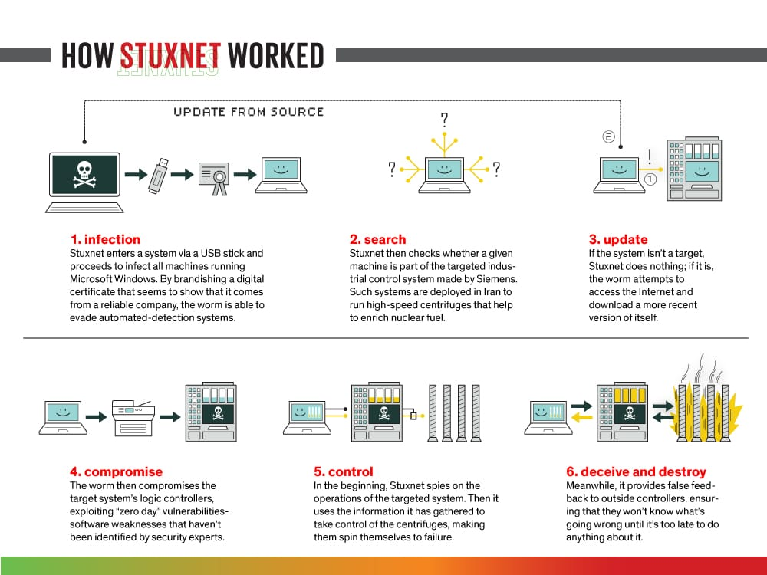

Slide 24
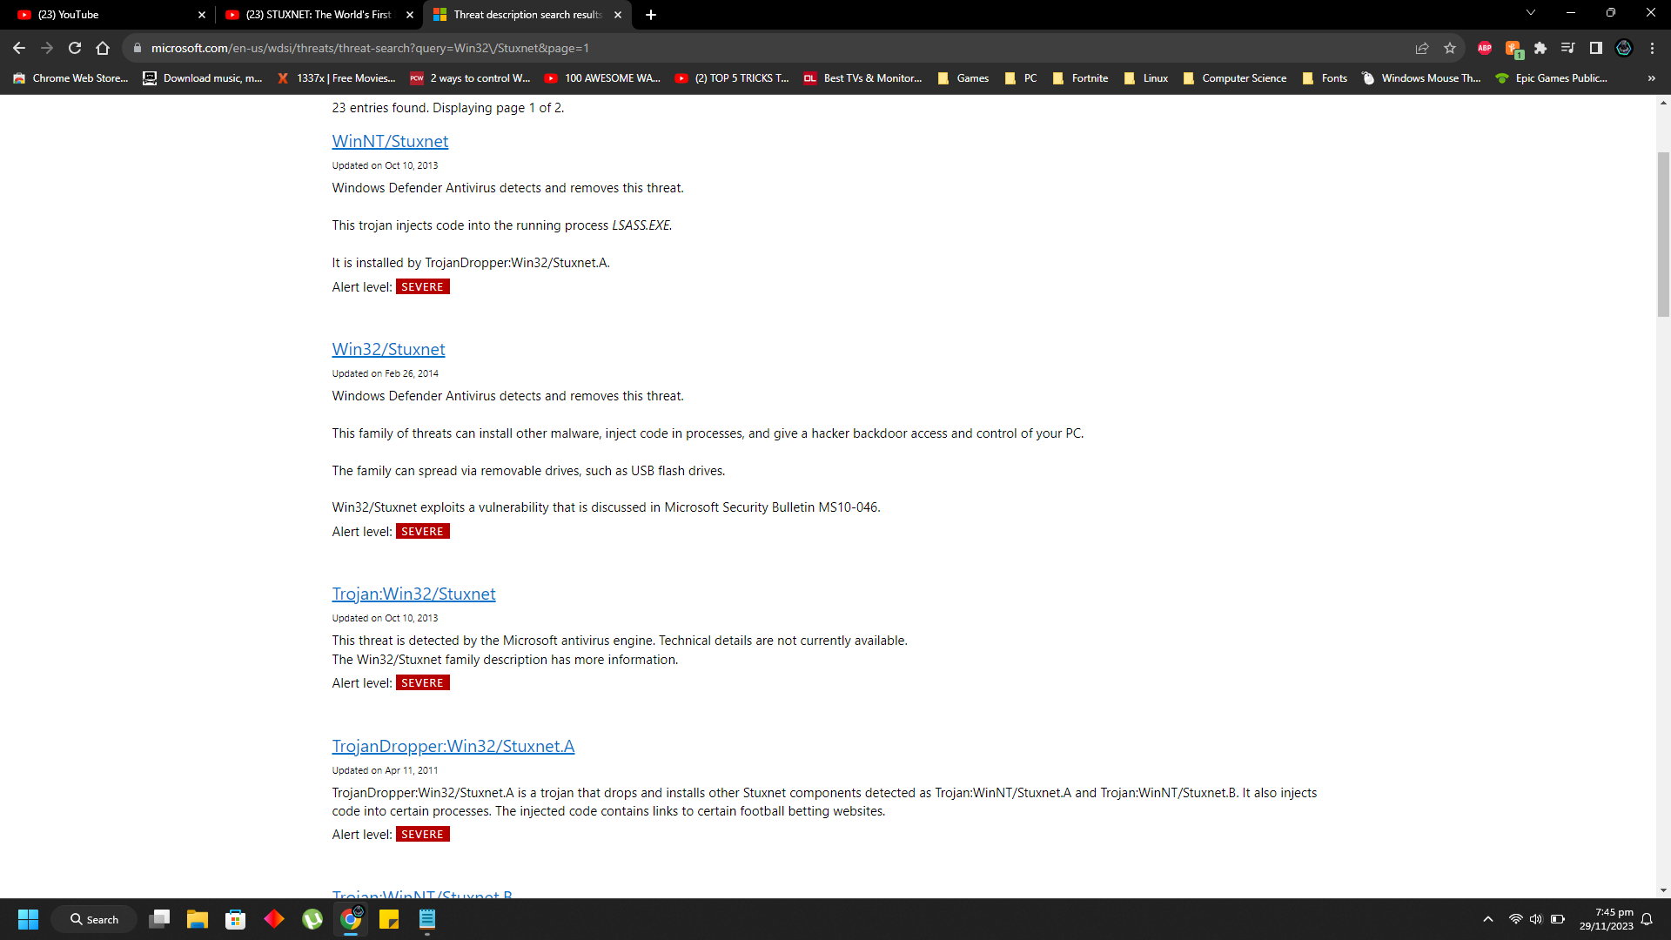
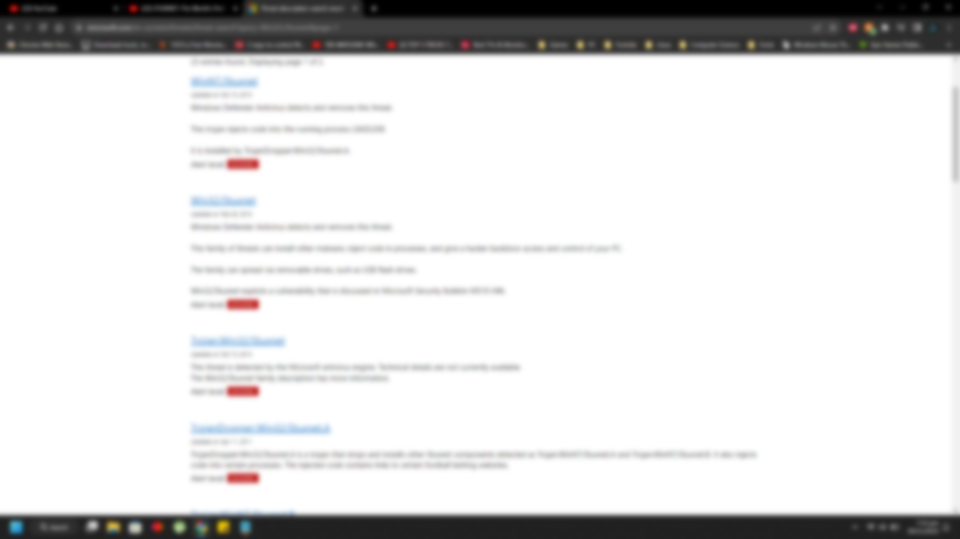

Slide 25
Questions ?

